Slide 1
Metal Casting
Lecture two
Introduction
Virtually nothing moves, turns, rolls, or flies without the benefit of cast metal products. The metal casting industry plays a key role in all the major sectors of our economy. There are castings in locomotives, cars trucks, aircraft, office buildings, factories, schools, and homes. (Figure 0) some metal cast parts. Metal Casting is one of the oldest materials shaping methods known. Casting means pouring molten metal into a mold with a cavity of the shape to be made, and allowing it to solidify. When solidified, the desired metal object is taken out from the mold either by breaking the mold or taking the mold apart. The solidified object is called the casting. By this process, intricate parts can be given strength and rigidity frequently not obtainable by any other manufacturing process. The mold, into which the metal is poured, is made of some heat resisting material. Sand is most often used as it resists the high temperature of the molten metal. Permanent molds of metal can also be used to cast products.

Slide 2
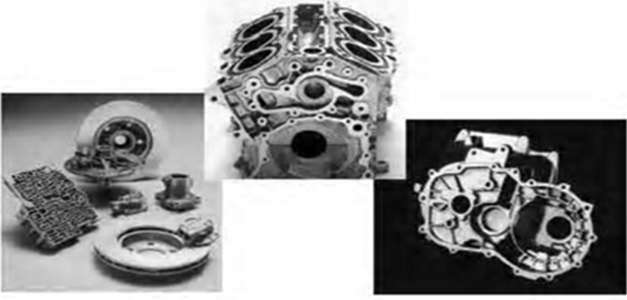
Figure 0: Metal Cast parts

Slide 3
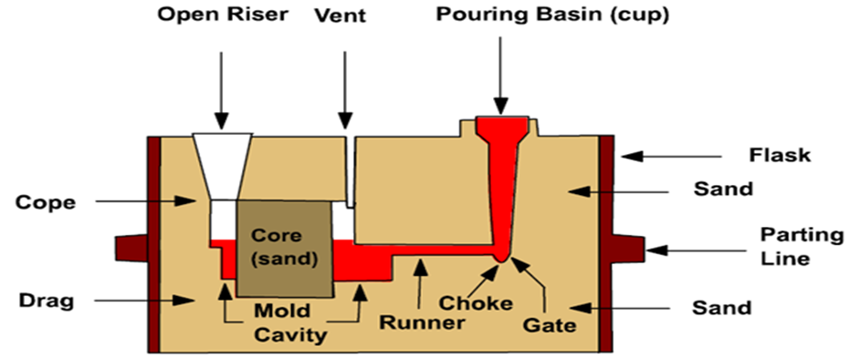
Casting Terms
1-Flask: A metal or wood frame, without fixed top or bottom, in which the mold is formed. Depending upon the position of the flask in the molding structure, it is referred to by various names such as
drag – lower molding flask, cope – upper molding flask, cheek – intermediate molding flask used in three piece molding.

Slide 4

2-Pattern: It is the replica of the final object to be made. The mold cavity is made with the help of pattern.
3-Parting line: This is the dividing line between the two molding flasks that makes up the mold
4-Molding sand: Sand, which binds strongly without losing its permeability to air or gases. It is a mixture of silica sand, clay, and moisture in appropriate proportions.
5-Facing sand: The small amount of carbonaceous material sprinkled on the inner surface of the mold cavity to give a better surface finish to the castings

Slide 5
6-Core: A separate part of the mold, made of sand and generally baked, which is used to create openings and various shaped cavities in the castings
7-Pouring basin: A small funnel shaped cavity at the top of the mold into which the molten metal is poured
8-Sprue: The passage through which the molten metal, from the pouring basin, reaches the mold cavity. In many cases it controls the flow of metal into the mold.
9-Runner: The channel through which the molten metal is carried from the sprue to the gat e.

Slide 6
10-Gate: A channel through which the molten metal enters the mold cavity
11-Chaplets: Chaplets are used to support the cores inside the mold cavity to take care of its own weight and overcome the metal static force.
12-Riser: A column of molten metal placed in the mold to feed the castings as it shrinks and solidifies. Also known as “feed head”
13-Vent: Small opening in the mold to facilitate escape of air and gases.

Slide 7
Steps in Making Sand Castings
There are six basic steps in making sand castings:
1. Pattern making
2. Core making
3. Molding
4. Melting and pouring
5. Cleaning
6. Inspection

Slide 8
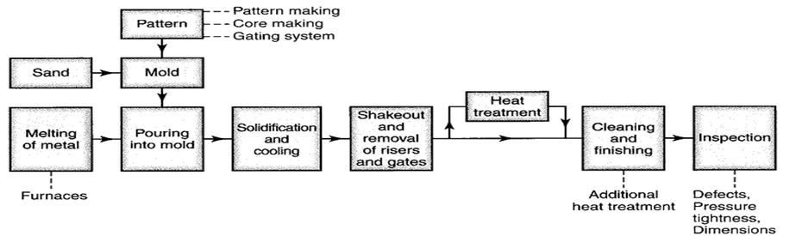

Slide 9
Pattern making
The pattern is a physical model of the casting used to make the mold. The mold is made by packing some readily formed aggregate material, such as molding sand, around the pattern. When the pattern is withdrawn, its imprint provides the mold cavity, which is ultimately filled with metal to become the casting. If the casting is to be hollow, as in the case of pipe fittings, additional patterns, referred to as cores, are used to form these cavities.
Core making
Cores are forms, usually made of sand, which are placed into a mold cavity to form the interior surfaces of castings. Thus the void space between the core and mold-cavity surface is what eventually becomes the casting

Slide 10
Molding
Molding consists of all operations necessary to prepare a mold for receiving molten metal. Molding usually involves placing a molding aggregate around a pattern held with a supporting frame, withdrawing the pattern to leave the mold cavity, setting the cores in the mold cavity and finishing and closing the mold.
Melting and Pouring
The preparation of molten metal for casting is referred to simply as melting. Melting is usually done in a specifically designated area of the foundry, and the molten metal is transferred to the pouring area where the molds are filled.
Cleaning
Cleaning refers to all operations necessary to the removal of sand, scale, and excess metal from the casting. Burned-on sand and scale are removed to improved the surface appearance of the casting. Excess metal, in the form of fins, wires, parting line fins, and gates, is removed. Inspection of the casting for defects and general quality is performed.

